Slide 1

Experiment Name:
Implementation of Modulo-8 Counter using 74LS93

Slide 2

Presented By Hasna Hena Joti (Roll : BFH2101006F) Pritom Mohajon (Roll: ASH2101007M) Mohammad Borhan Uddin (Roll: ASH2101008M)
Fateha Nour Meshu (Roll: BFH2101009M)
Shafkat Niloy (Roll: ASH2101010M)

Slide 3
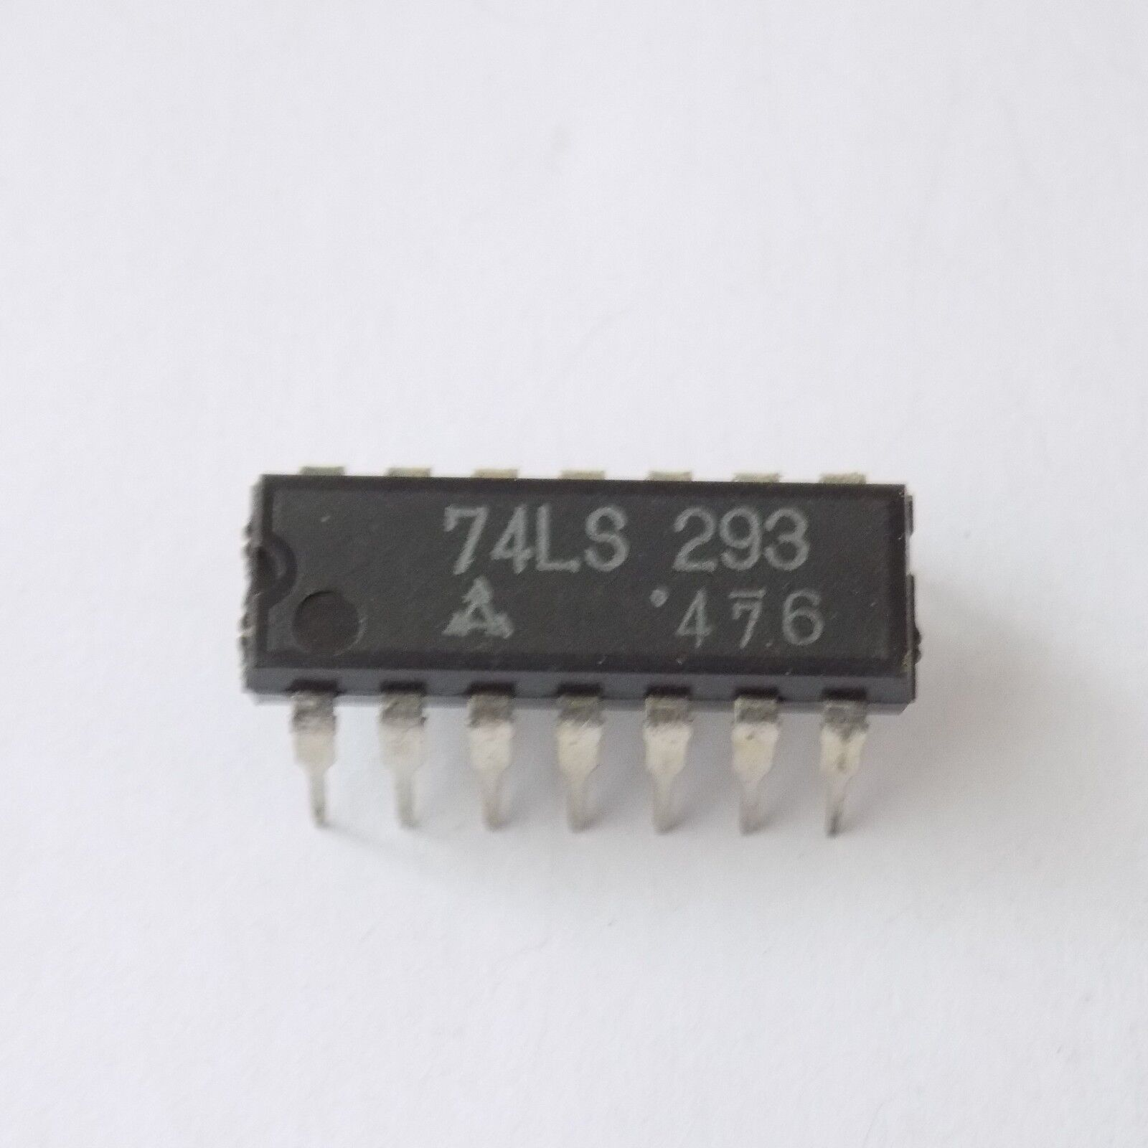
Experiment : Implementation of Modulo-8 Counter using 74LS93
Objective: The objective of this experiment is to demonstrate the implementation of a modulo-8 counter using the 74LS93 chip. The counter should count from 0 to 7 and then wrap back to 0.
Components:
74LS93 Chip
Clock Pulse
Bread Board
Connecting Wires
Trainer Board
LED
IC 74LS93

Slide 4
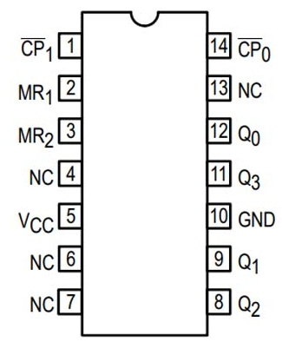
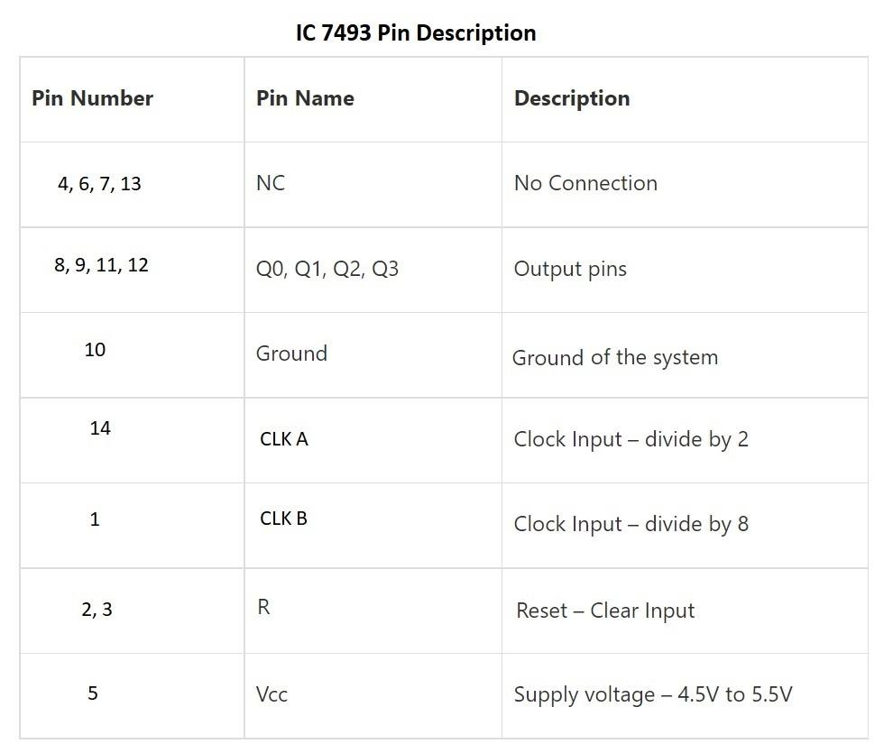
Pin Configuration of 74LS93

Slide 5
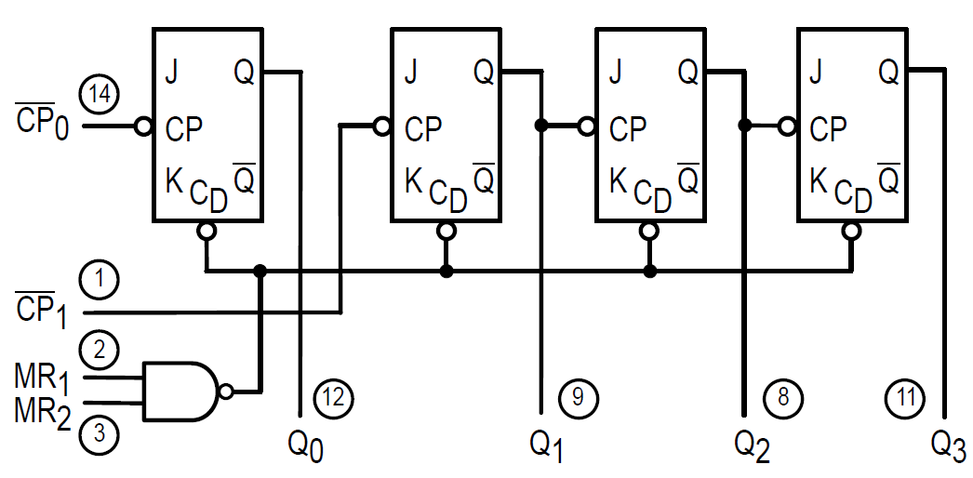
Internal Circuit Diagram 74LS93
1. The 74LS93 chip consists of four flip-flops connected in a cascade configuration.
2. Each flip-flop represents one bit of the counter, allowing the chip to count from 0000 to 1111 (0 to 15) in binary.
3. The clock input drives the first flip-flop and propagates through the subsequent flip-flops.
4. The MSB flip-flop generates a ripple carry signal when the count reaches its maximum value (1111).
5. The chip includes reset inputs to externally reset the counter.

Slide 6
Procedure:
Set up the breadboard and ensure the power supply is disconnected.
Place the 74LS93 chip on the breadboard, ensuring proper orientation.
Connect the pin 14 of the 74LS93 chip to the positive terminal of the power supply.
Connect the pin 7 to the negative terminal of the power supply.
Connect pin 9 to the input of the least significant bit (LSB) counter.
Connect pin 8 to the input of the second bit counter.
Connect pin 7 to the input of the most significant bit (MSB) counter.
Connect pin 6 to the ground rail of the breadboard.
Connect pin 5 to pin 4, creating a feedback connection for counter reset.
Connect pin 3 of the 74LS93 chip to the input of the third bit counter.
Connect pin 15 of the 74LS93 chip to the output of the MSB counter.
12. Once satisfied with the setup, connect the positive and negative terminals of the power supply to the breadboard to power up the circuit.
13. Verify that the counter counts from 0 to 7 and wraps back to 0, demonstrating the modulo-8 functionality.

Slide 7
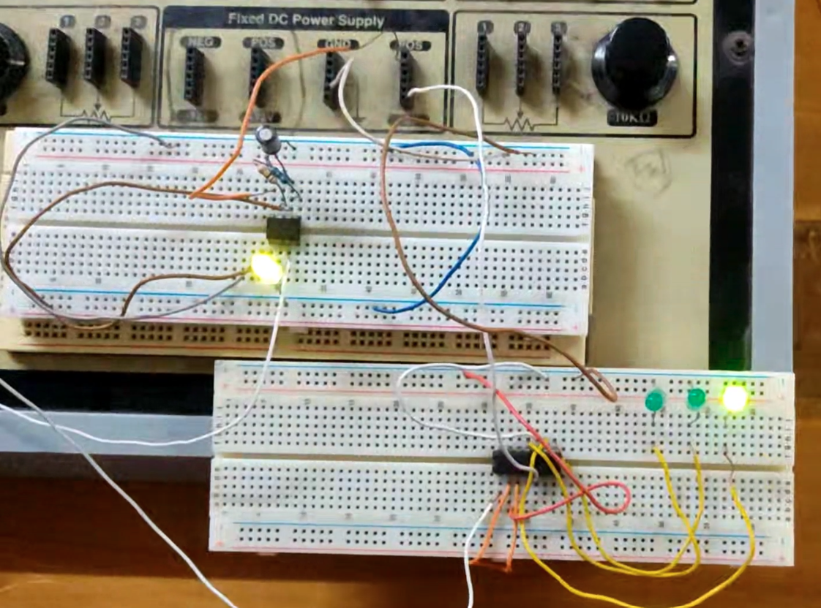
Circuit

Slide 8
Truth Table
CLK | QD | QC | QB | QA | Decimal Equivalent
Initially | 0 | 0 | 0 | 0 | 0
1st | 0 | 0 | 0 | 1 | 1
2nd | 0 | 0 | 1 | 0 | 2
3rd | 0 | 0 | 1 | 1 | 3
4th | 0 | 1 | 0 | 0 | 4
5th | 0 | 1 | 0 | 1 | 5
6th | 0 | 1 | 1 | 0 | 6
7th | 0 | 1 | 1 | 1 | 7
8th | 0 | 0 | 0 | 0 | 0
9th | 0 | 0 | 0 | 1 | 1

Slide 9
How does it work?
Initialize Counter
(Set to 0000)
START
Read Clock Input
Increment Counter
Show Counter
False
Counter >= 0111
Continue
True
Reset Counter
(0000)

Slide 10
Video

Slide 11
Thank you!

